Slide 1
21AIE304 BIG DATA MANAGEMENT SYSTEMS
PROJECT
TEAM-08

Slide 2
TEAM-5 MEMBERS
Ameen Ashadullah M - CB.EN.U4AIE20004
Ghaayathri Devi K - CB.EN.U4AIE20017
Gorantla V N S L Vishnu Vardhan CB.EN.U4AIE20019
Menta Sai Aashish - CB.EN.U4AIE20039
Sai Aravind V - CB.EN.U4AIE20062

Slide 3
TWITTER LIVE FEED ANALYSYS AND STREAMING
FOR MOVIE AND COVID BASED TWEERS

Slide 4
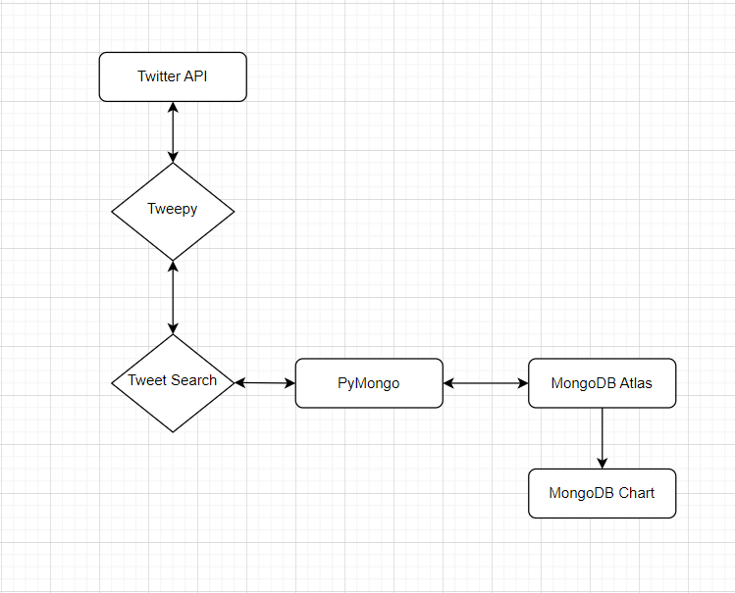

Slide 5
DATA - STREAMING AND CREATION

Slide 6
To Get a Twitter Api
Create a Twitter Developer Account
Get an elevated Access
Create An application under a project
Give access to the application
Get the authentication credentials

Slide 7
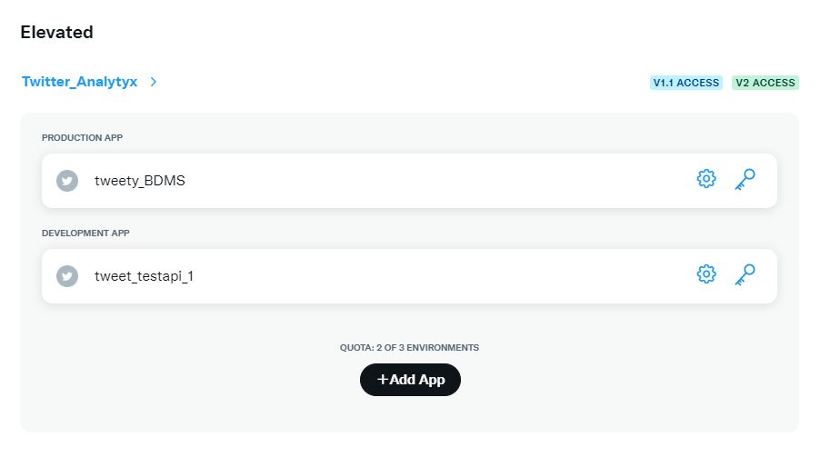
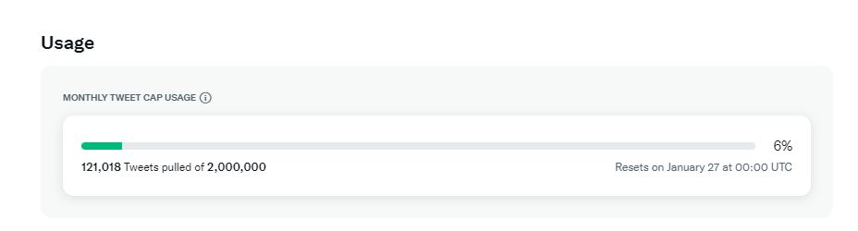
TWITTER API

Slide 8
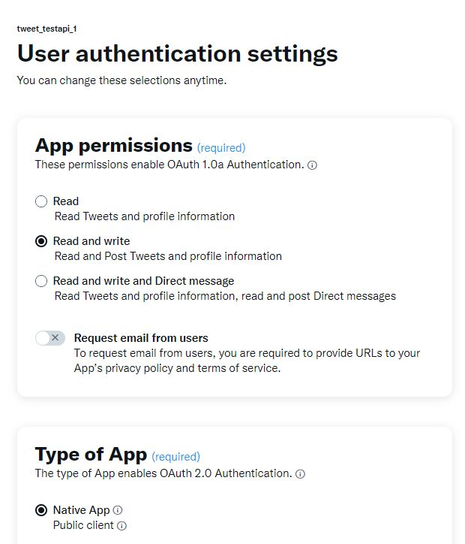
GIVING ACCESS FOR TWITTER API

Slide 9
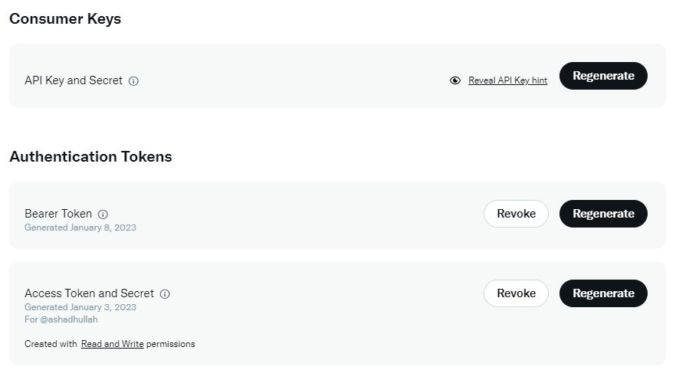
AUTHENTICATION KEYS

Slide 10
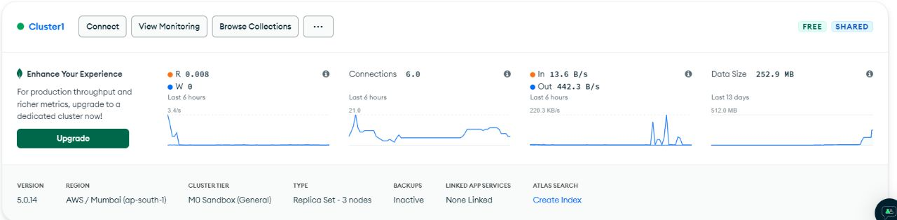
MONGODB CLUSTER

Slide 11
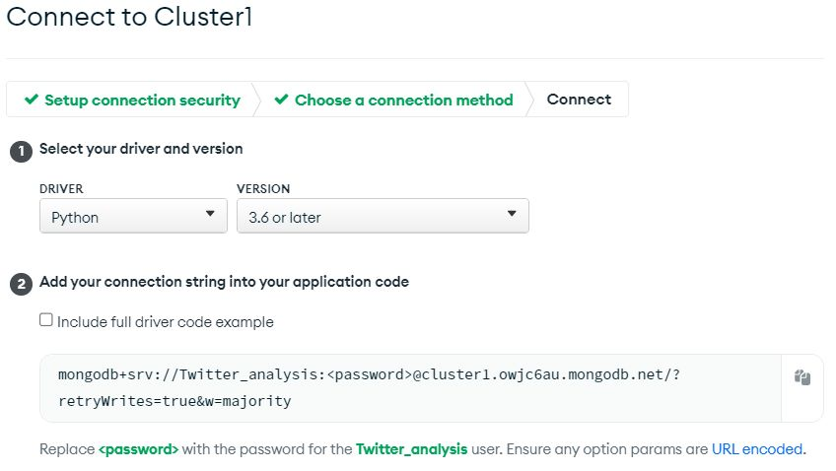
MONGODB URI CONNECTION STRING

Slide 12
We use tweepy module to access and stream the twitter data
We authenticate the api using the authentication credentials:
Consumer_key
consumer_secret
access_token
Access_secret

Slide 13
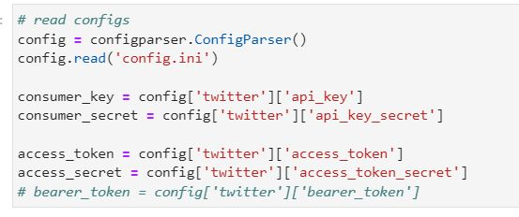
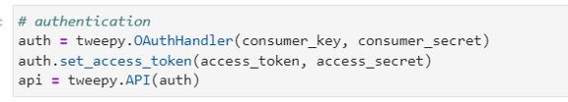
Authenticating API with keys

Slide 14
Connecting to DataBase:
Create an account in mongodb atlas
Create database in atlas
Giving the network accessibility in atlas
We can get the URI connection string and we can access and modify the data in mongodb database

Slide 15
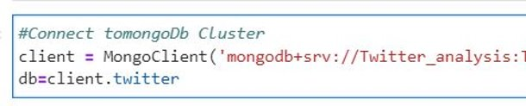
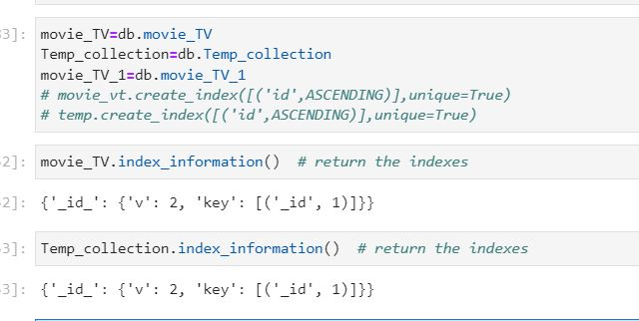
CONNECTING MONGODB AND CREATING COLLECTION

Slide 16
Streaming the twitter data:
search _Tweets function helps us to search and get the recent tweet with different parameters
API.search_tweets(q, *, geocode, lang, locale, result_type, count, until, since_id, max_id, include_entities)

Slide 17
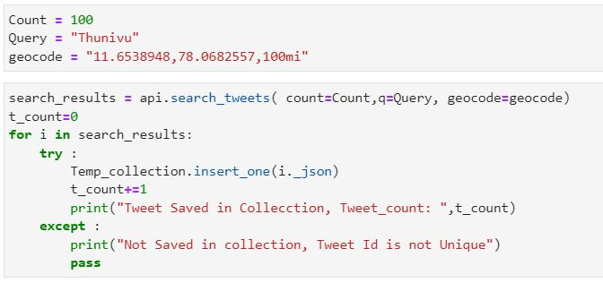
GETTING API FROM SEARCH_TWEETS FUNCTION

Slide 18
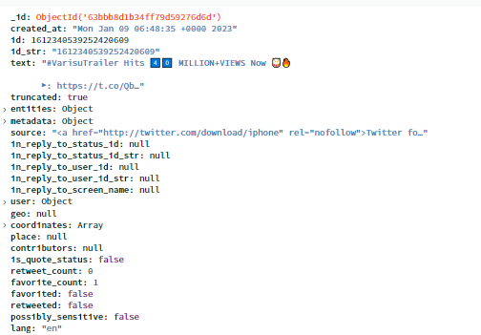
COMPLETE DATA OF SINGLE TWEET

Slide 19
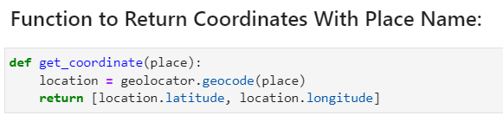
ANALYSING TWEET DATA AND UPDATING THE LOCATION COORDINATES ,MOVIE NAME AND TWEET TYPES

Slide 20
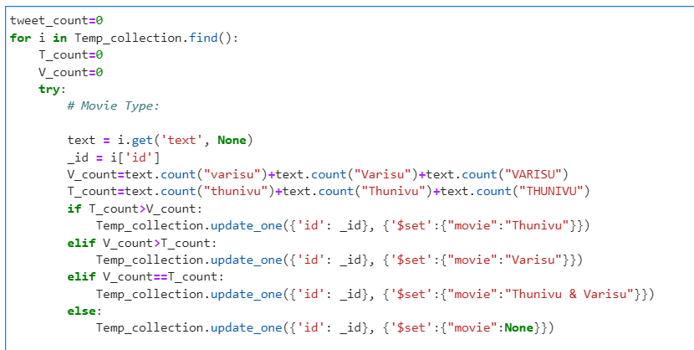

Slide 21
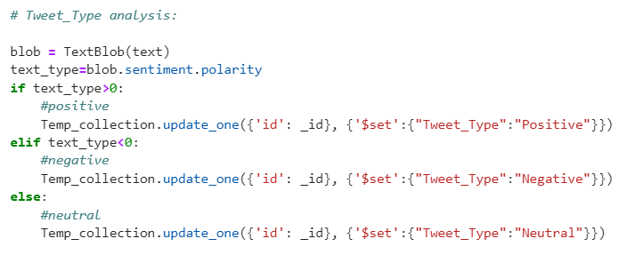

Slide 22
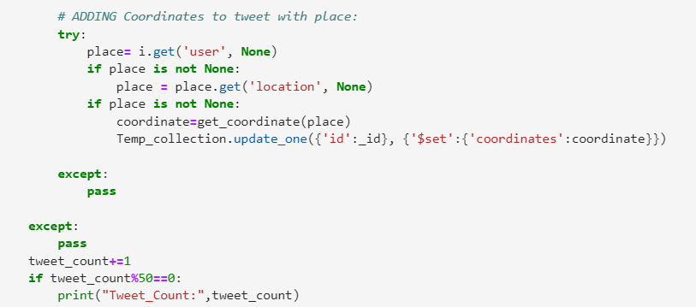

Slide 23
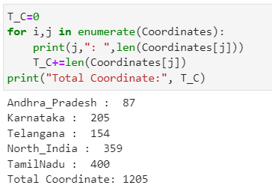
Coordinates list of various place:

Slide 24
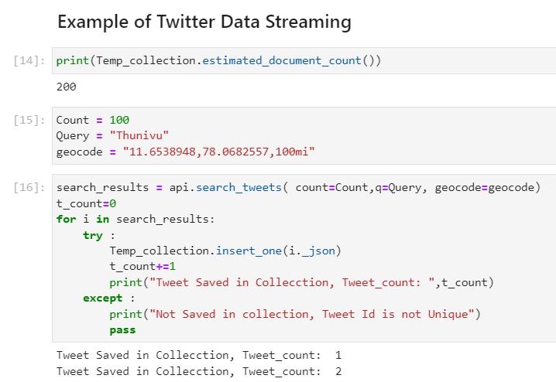

Slide 25
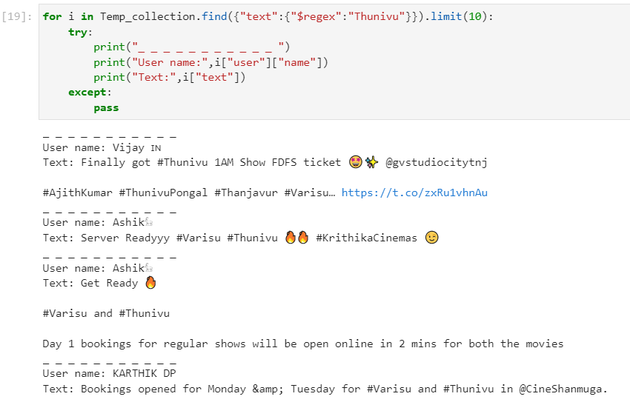

Slide 26

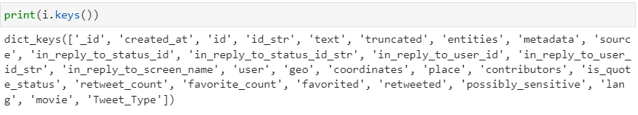
Main Fields in tweet data

Slide 27
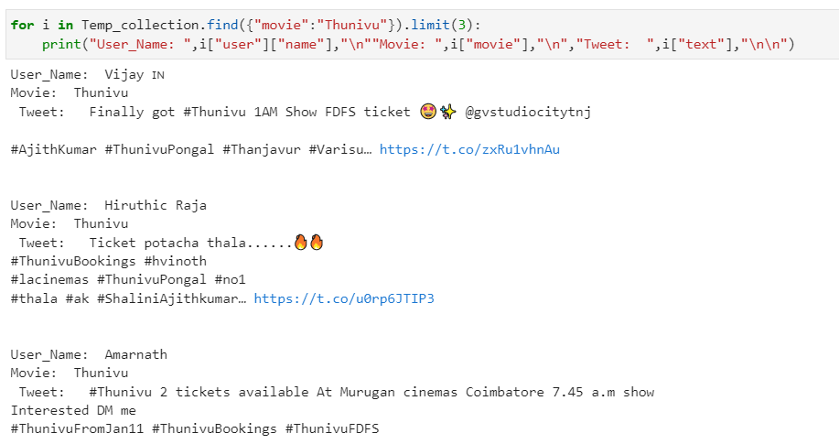
After Setting Coordinates, Movie Name And
Tweet_Type:

Slide 28
Tweet Data Analysis

Slide 29
MongoDb Chart Analysis

Slide 30
Link For Analysis Chart
Movie Analysis Chart

Slide 31
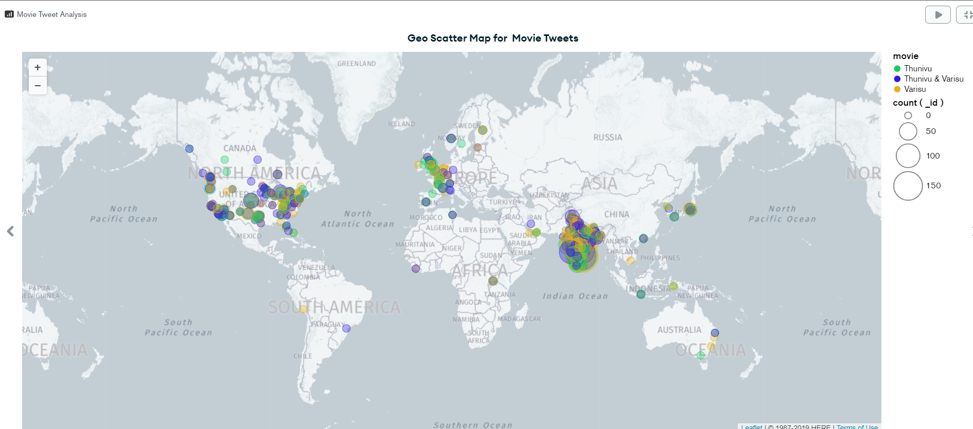
GEO SCATTER MAP FOR MOVIE TWEETS

Slide 32
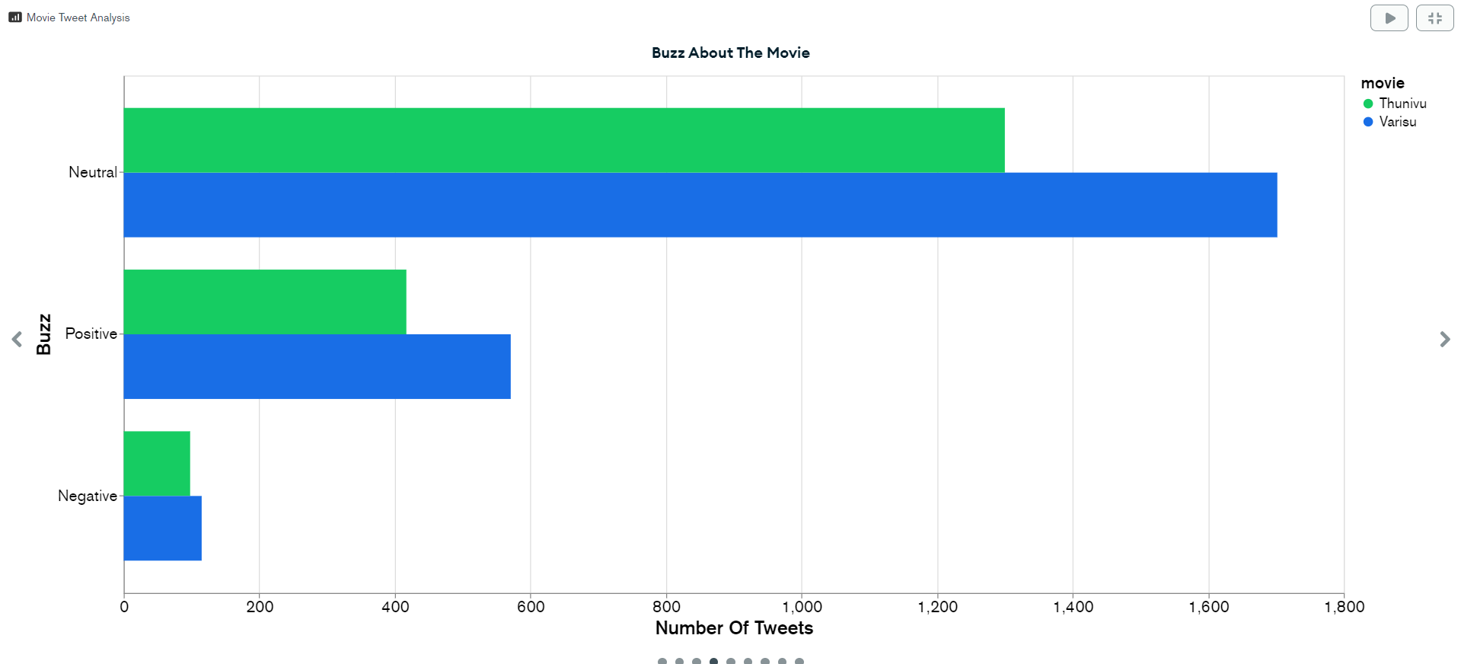
BUZZ ABOUT THE MOVIE

Slide 33
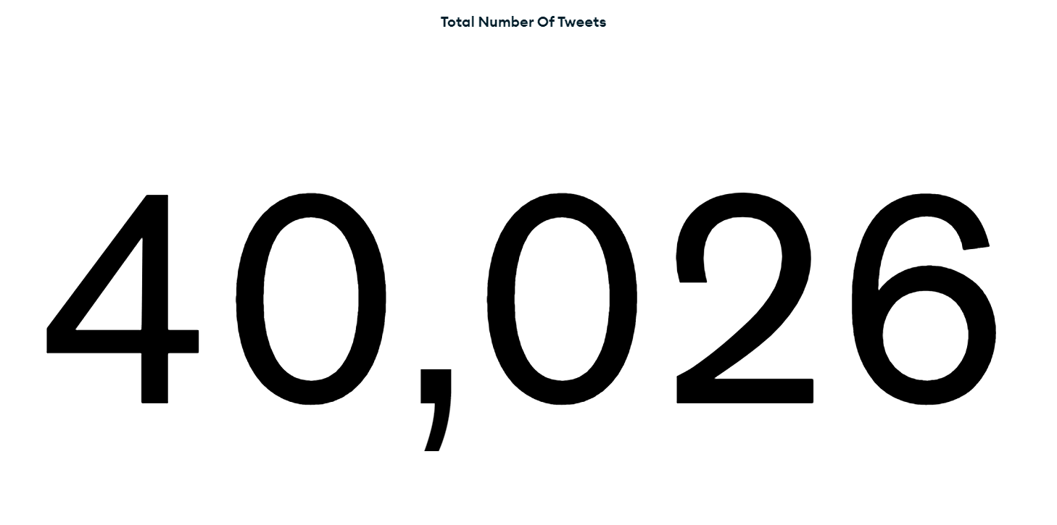
TOTAL NO OF TWEETS

Slide 34
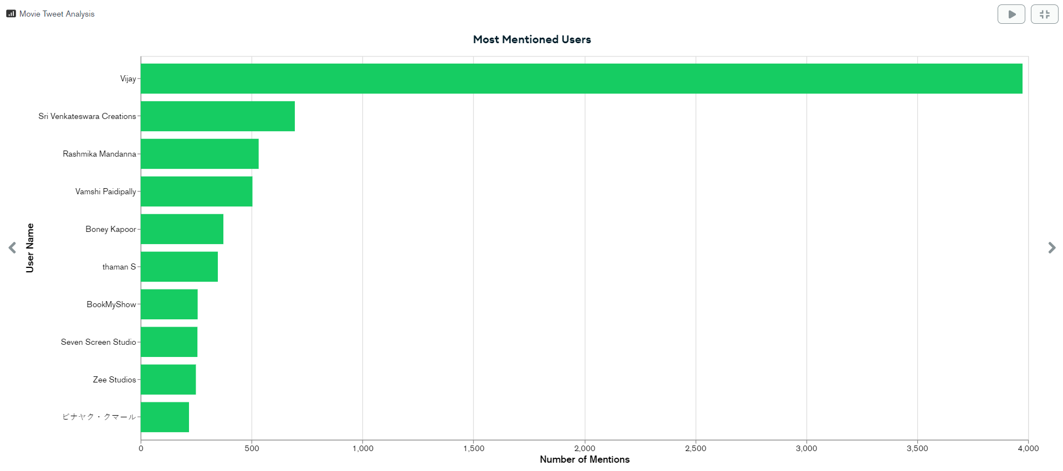
MOST MENTIONED USERS

Slide 35
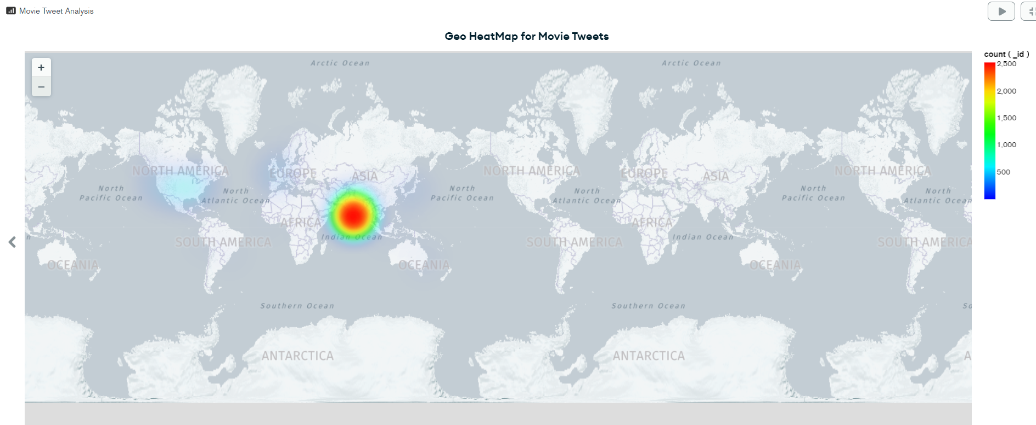
GEO HEATMAP FOR MOVIE TWEETS

Slide 36
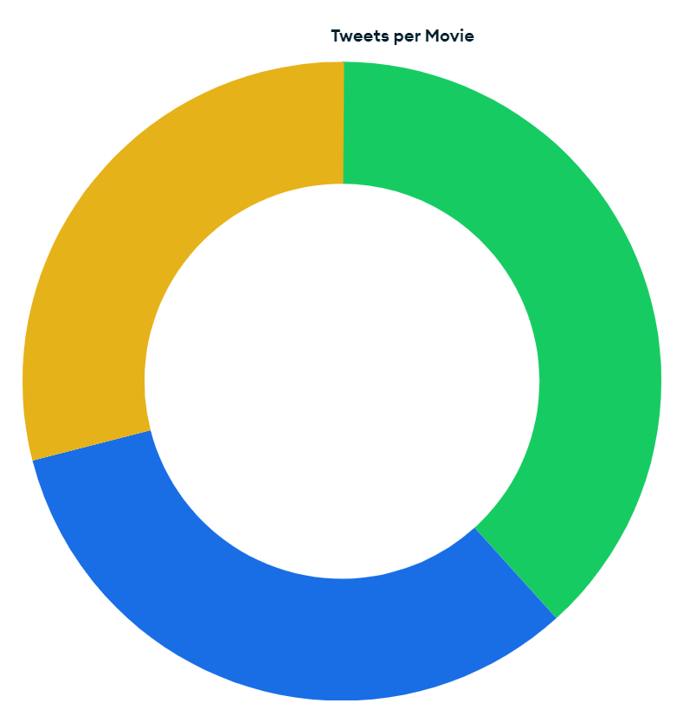
TWEETS PER MOVIE PIECHART

Slide 37
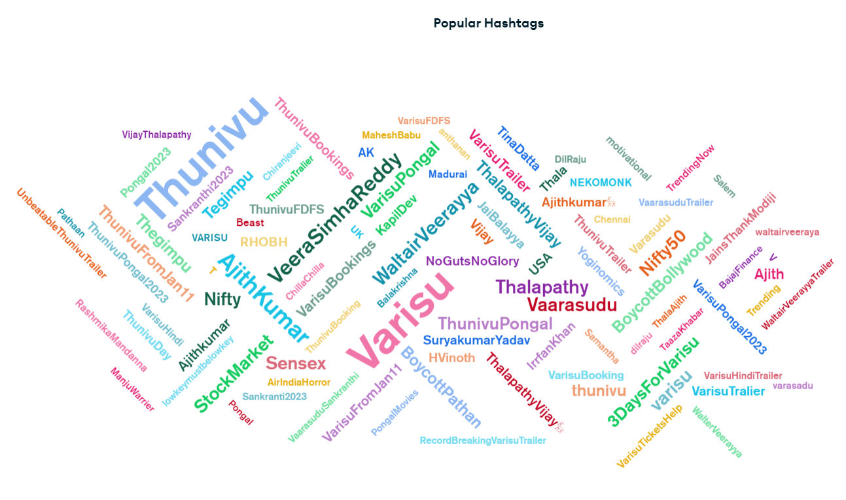
POPULAR HASHTAGS

Slide 38
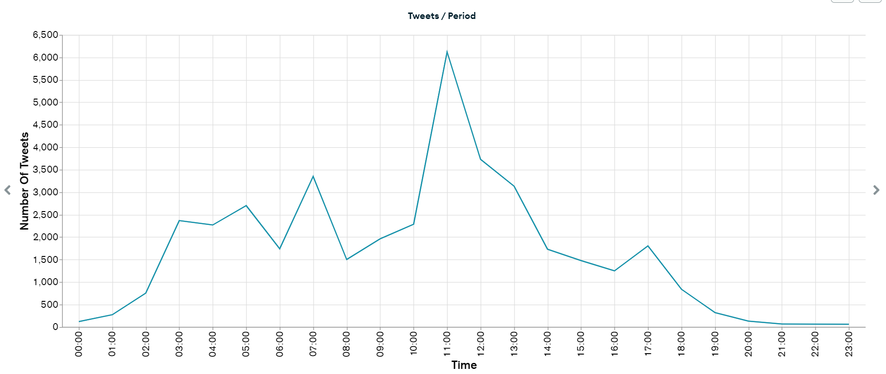
TWEETS/PERIOD

Slide 39
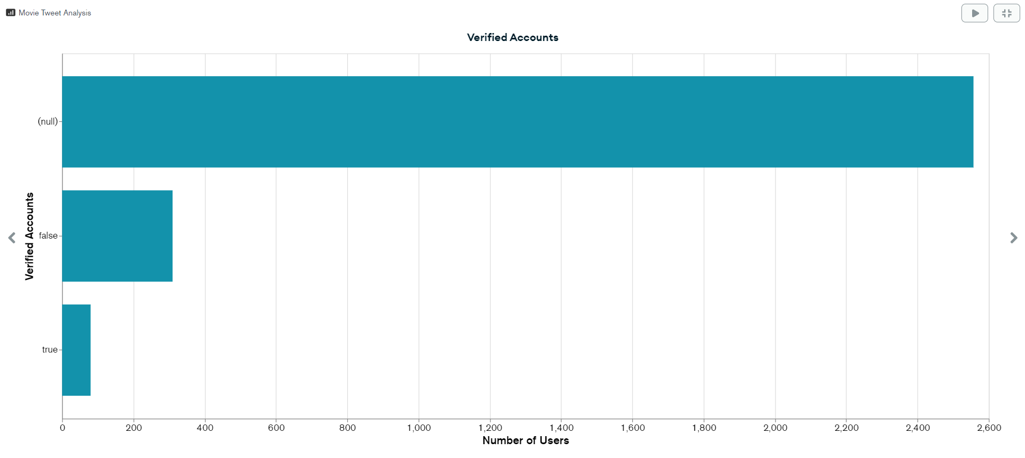
VERFIED ACCOUNTS

Slide 40
Querying MongoDb DataBase:

Slide 41
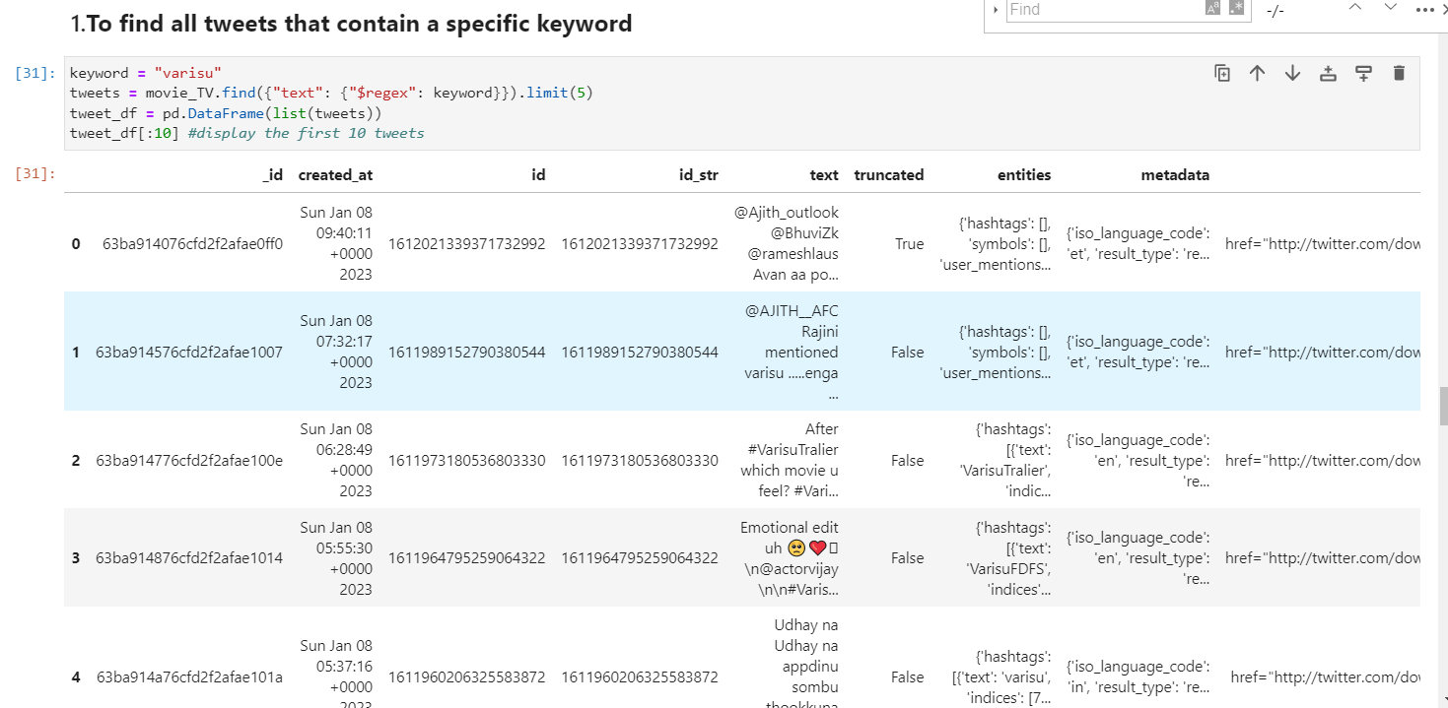

Slide 42
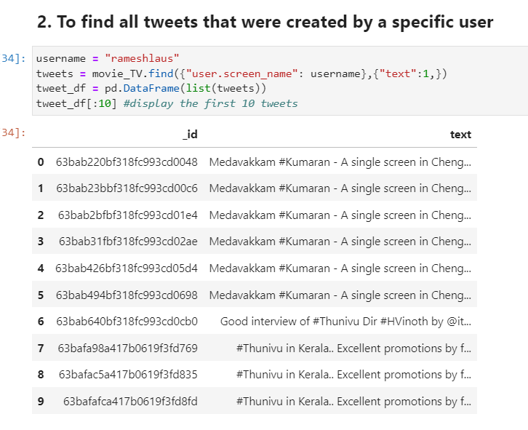

Slide 43
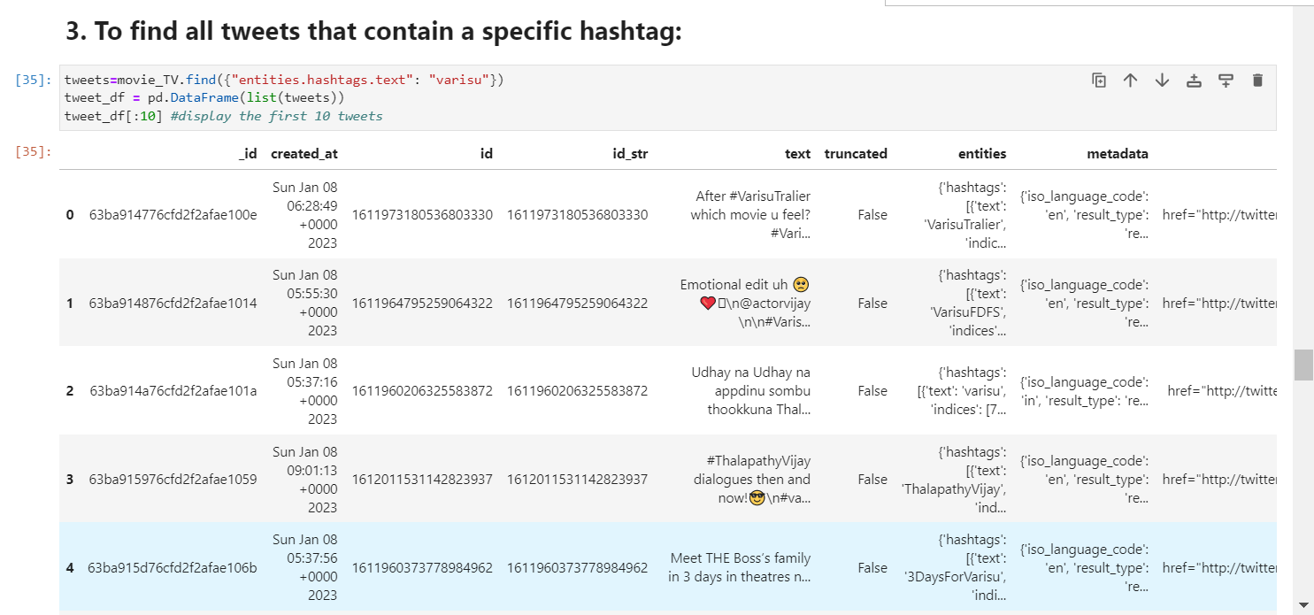

Slide 44
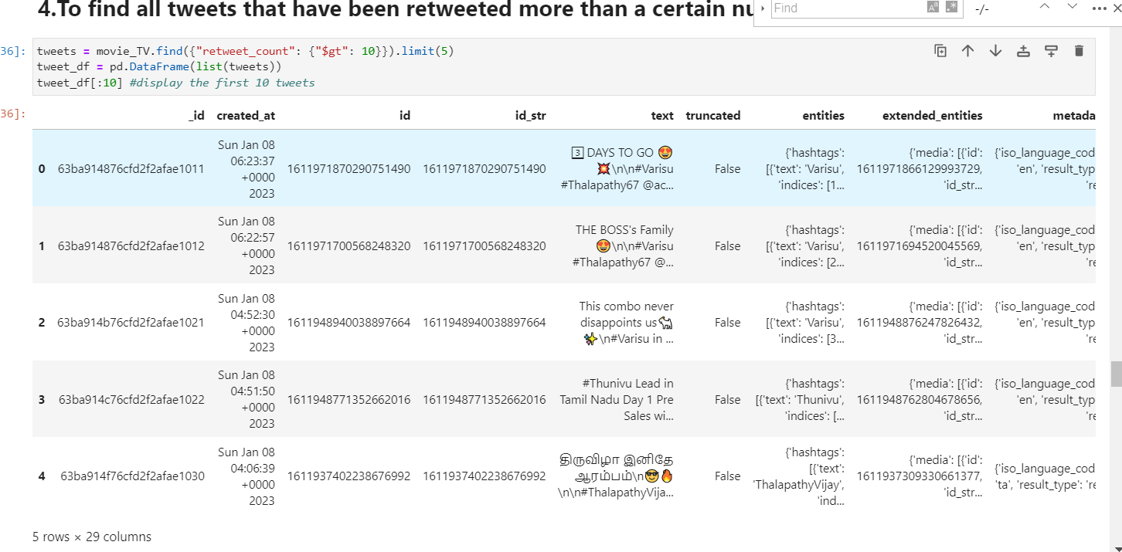

Slide 45
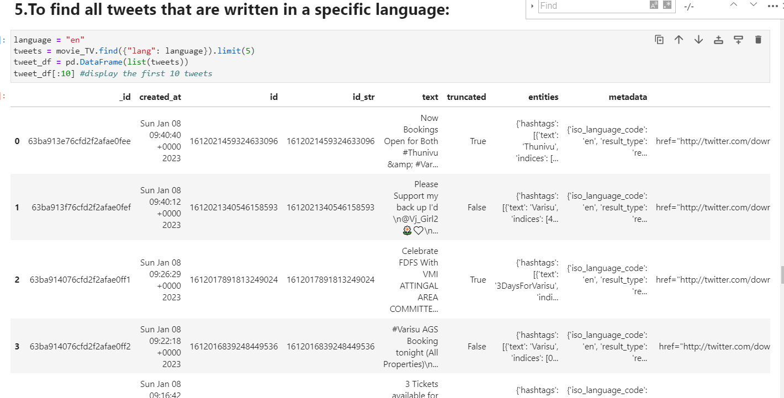

Slide 46
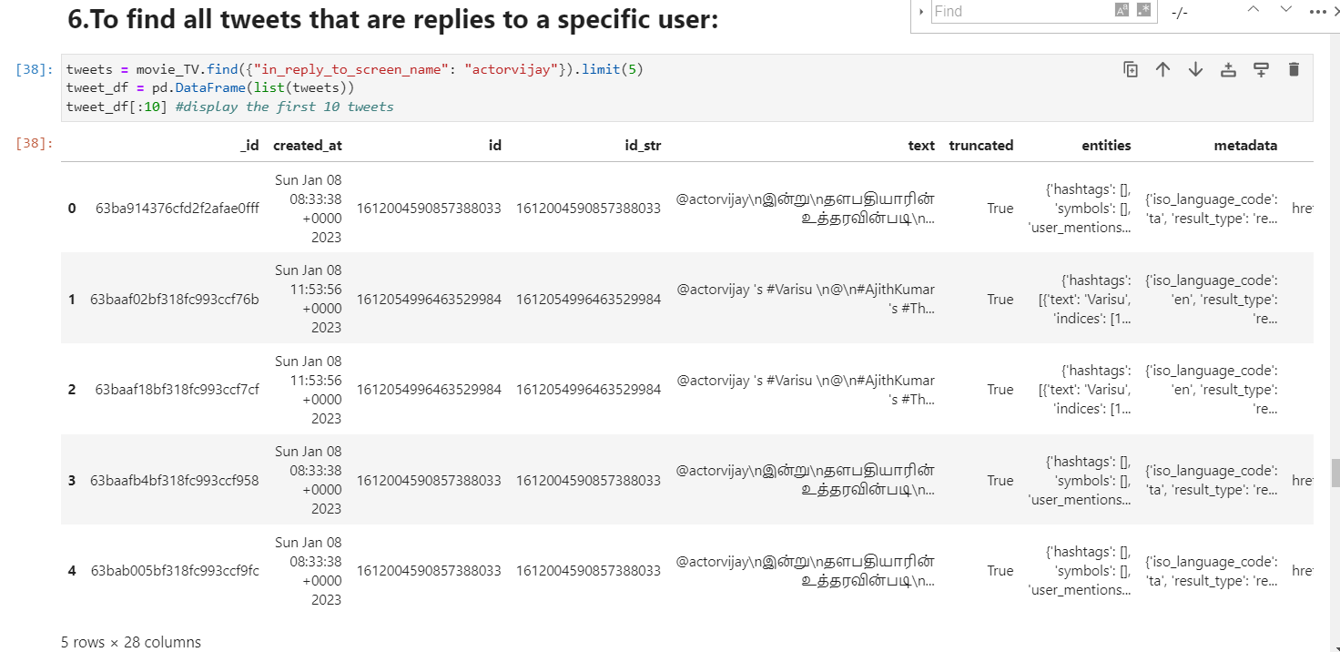

Slide 47
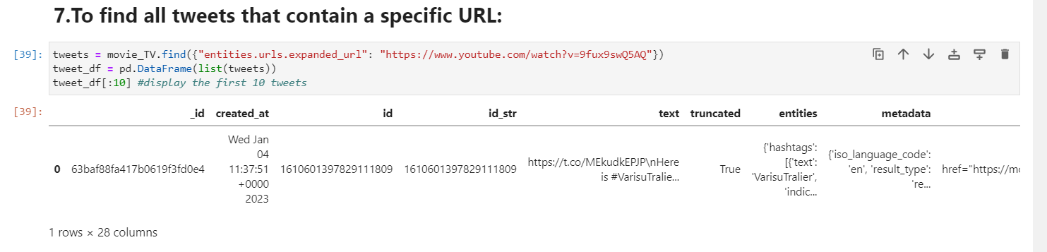

Slide 48
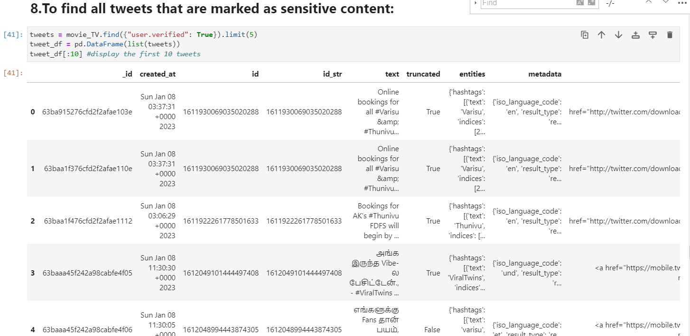

Slide 49
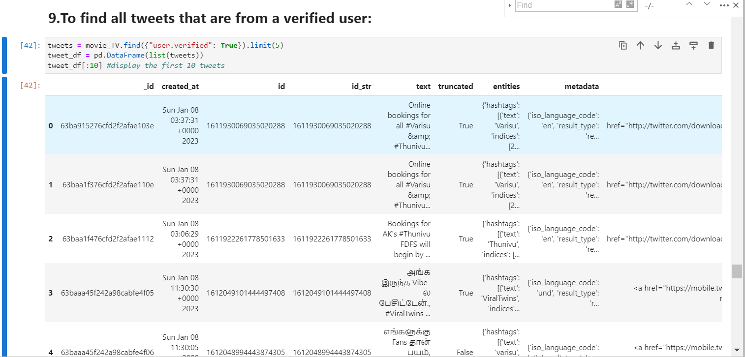

Slide 50
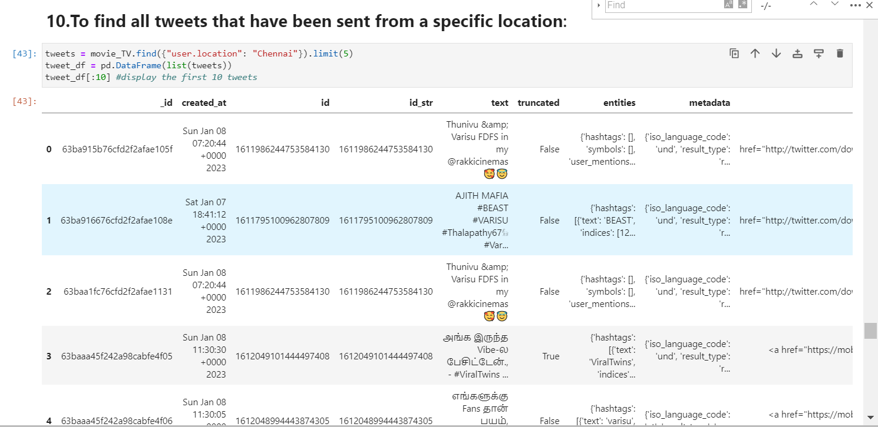

Slide 51
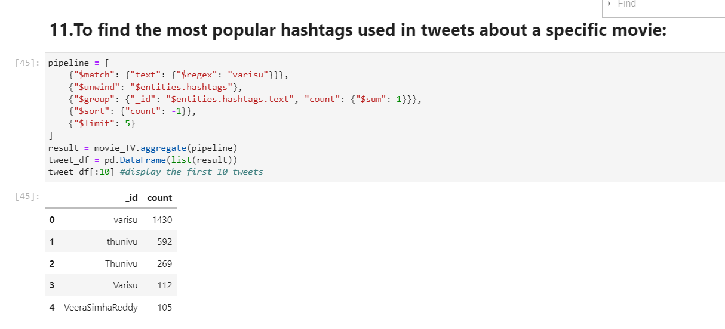

Slide 52
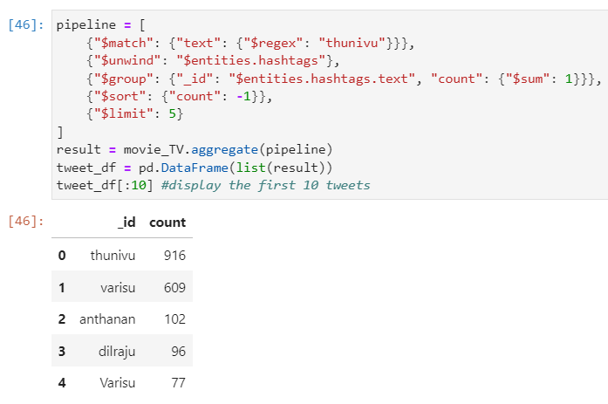

Slide 53
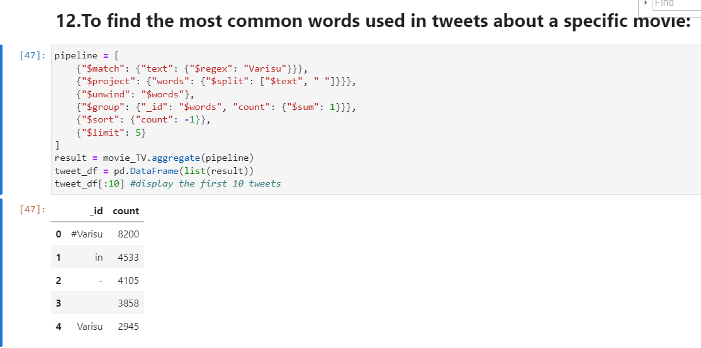

Slide 54
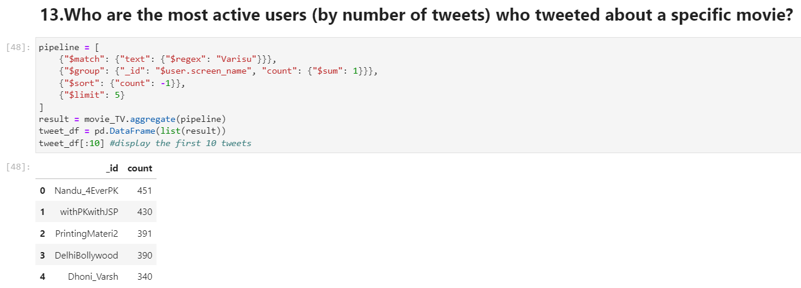

Slide 55
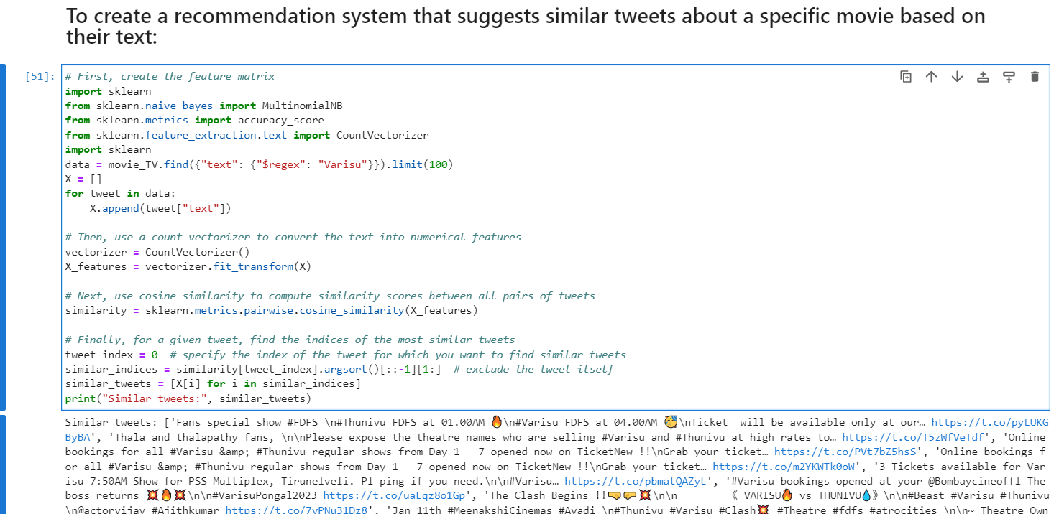
Code_Link

Slide 56
Thank You

